Slide 1

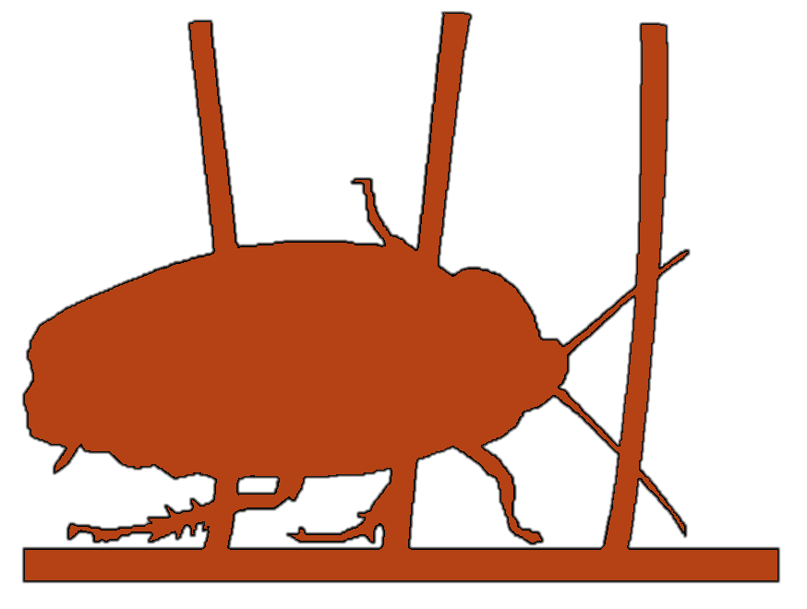
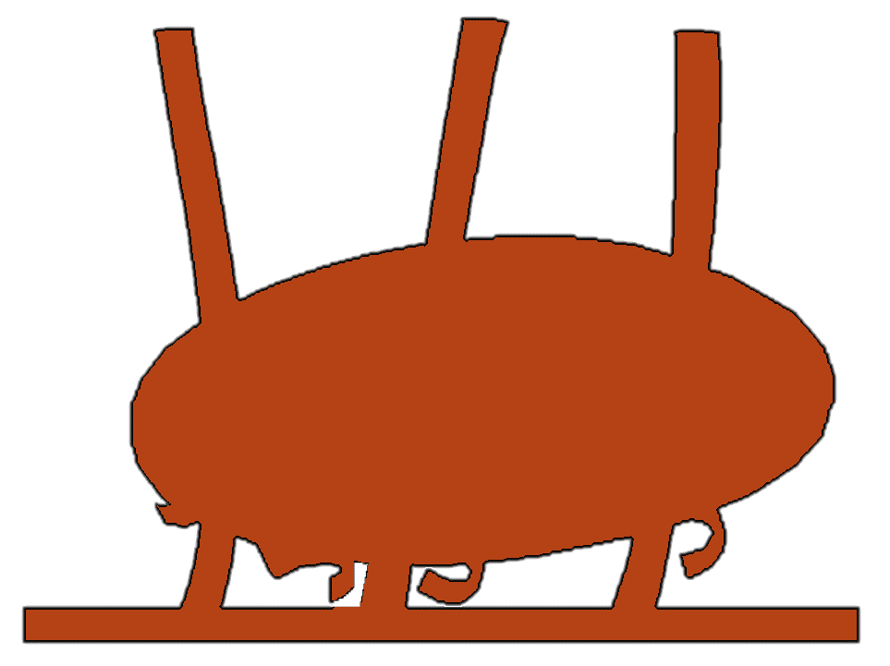



Terradynamics Lab
Movement Science at the Interface of Biology, Robotics, & Physics
Wavelet Transform
Aaron Z GUAN
Notes:
Last week I found the transition matrix first, and then plot the matrix on the behavioral map itself, we can clearly see the distribution of the transition between behaviors.

Slide 2
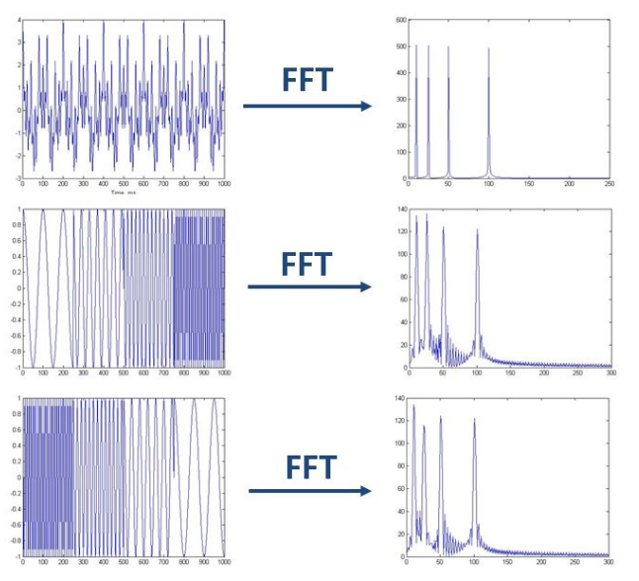
Why don’t use Fourier transform?
FT shows what frequencies exist in the signal, but no time information on when they occur.

Slide 3
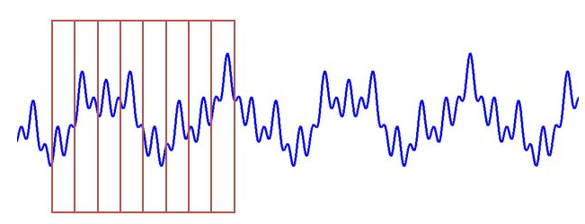
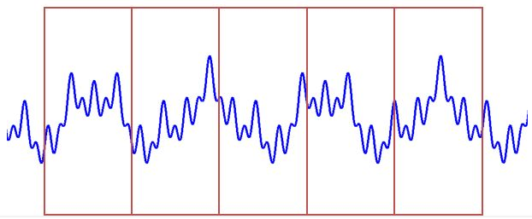
Why don’t use STFT?
STFT is described as a windowing of the signal to create a local frequency analysis. But the window size is constant.
We no longer know the exact frequency components that exist in the signal, but we only know a band of frequencies that exist.
Narrow window
Wide window
good time resolution, poor frequency resolution
good frequency resolution, poor time resolution

Slide 4
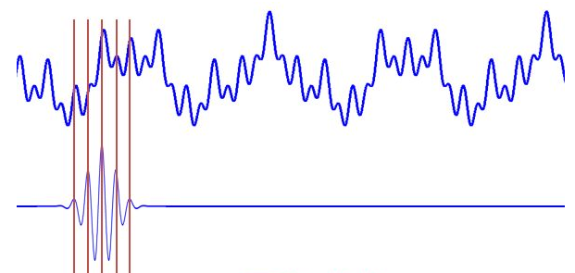
Why use wavelet transform?
Similar to STFT, but the width of the window can be changed.
Wavelet: small(finite) wave.
The transformed signal is a function of two variables, the translation (time) and scale(window size)

Slide 5
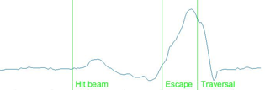
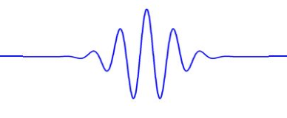
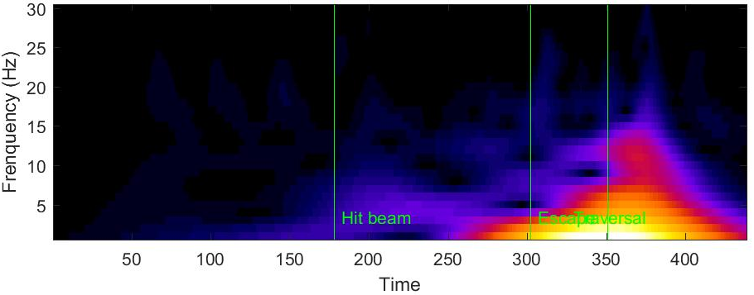
Wavelet Transform
Time series
Wavelet
(small scale)
Wavelet
(large scale)
Spectrogram
Notes:
I did wavelet transform for each time series. The vertical line one the time series indicates when the robot hit beam, escape and also traversal. Wavelet simply means small finite wave. So basically wavelet transform uses wavelet to compute the frequency at a finite region. And then shift to the next time until the end of the signal. After that, it increases the size of the wavelet, so the scale of the wavelet become larger, then do the above computation over again. That’s how we can get the spectrogram of this time series.

